Slide 1

Team 4.11
"My assignment is heavy, and that's just the way it is"
Notes:
This is Leila’s 4th night shift in a row.
Leila isn’t one to voice her opinion; she takes her assignments as they come, no matter how heavy the workload.
She has 2 total care patients, one has a trach and is on COVID precautions, and the other is on a heparin infusion, requiring frequent lab draws.
Leila feels like her assignment is unfairly designed, she is BURNT OUT.
This is the reality of nurses.

Slide 2
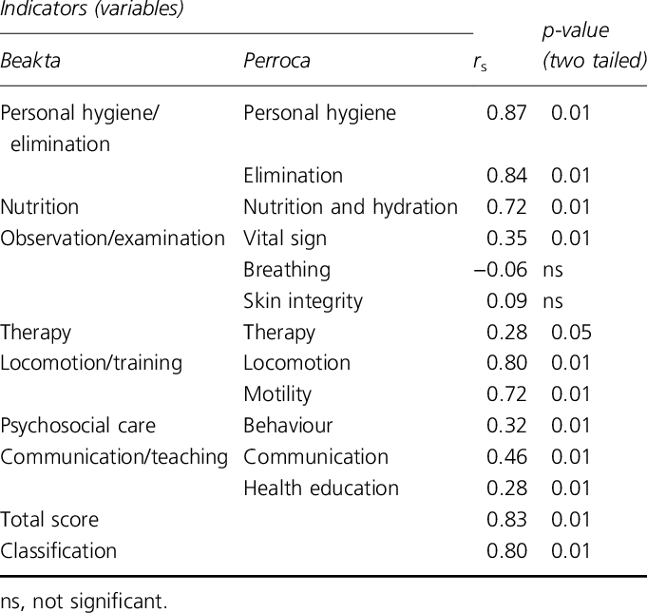


No Focus on the Workload
Team 4.11
Assignments are heavily subjective
Patient Classification Systems (PCAs)
Beakta (Sweden) and Perroca (Brazil)
Let's classify patients
Nancy's assignment is so light compared to mine!
Notes:
Now lets look at the problem. How are current nurse assignments made:
There is no focus on the workload!!!
Current practice:
Charge nurse’s personal judgement is used in determining nurse assignments
Existing models listed on the slide DO NOT track nurse workload. They are used for budgeting and staffing allocation.
Paper check list tools are used to gather patient acuity but not nurse workload.

Slide 3

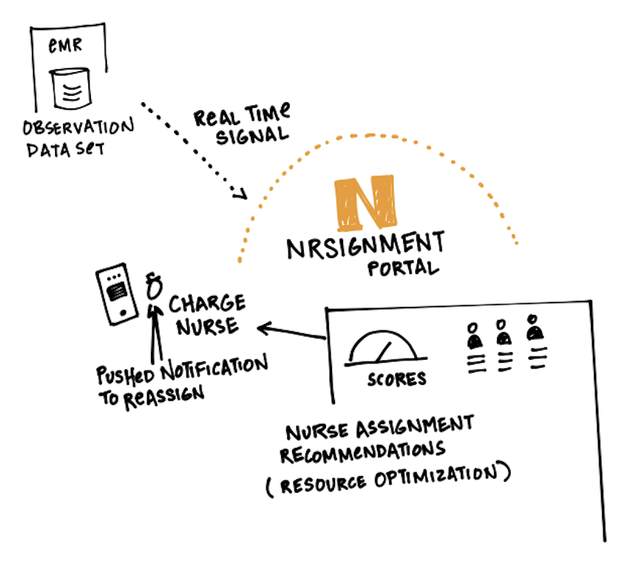

Team 4.11
NRSignment
5/16/2021
Notes:
Here lies the problem: Nurse assignments are NOT data driven. The GAP we are trying to resolve is that nursing assignments are made based on data and NOT subjective analysis of charge nurses.
Our product will extrapolate discrete data sets from the EMR to calculate workload of each patient and display it on a dashboard. These key data points pulled will look at such things as the number of medications, frequency of assistance, nursing tasks that consume a lot of time.
The current nurse burn out rate in the US is estimated between 35-45%. Biggest reason for nurse burn out is WORKLOAD. Consequences of Unequal Nurse assignments leads to delays in patient care, through-put and ultimately higher burn out rates.

Slide 4

EXAMPLE 1 – Our Solution vs. The Competition
Team 4.11
Benefits | Our Solution | US Patient Classification Systems (PCAs) | Perroca | Beakta
Address nurse workload |  | X | X | X
Automation |  | X | X | X
Cost to Use | Cost to build/test/deploy | n/a | n/a | n/a
Platform | Existing EMR | Paper checklist | Checklist | Checklist
Users | Nurse managers/ Charge nurses | Nurse execs, managers | Nurse execs, managers | Nurse execs, managers

Slide 5

B2B Strategy
Team 4.11
Directly to the hospital administrators in charge of purchasing the EMR systems
The EMR companies could make it an add on feature on their products
Notes:
Our strategy and business plan will consist of four core phases, all leading up to the implementation phase and monitoring for growth optimization
Phase 1
Pilot the study in a step down or telemetry unit, and gather preliminary data and processes
Collaborate with product and design team
Phase 2
Beta testing and test scripting with internal team
Phase 3
Training key stakeholders
Go-live and post-live support for pilot area
Phase 4
Gather post-interventional data, establish lessons learned, and improve tool as warranted/needed
As we look to optimize and continue to innovate this tool, we forecast future utility of the tool leveraging AI and machine learning in revolutionizing current processes such as Early Warning Scoring, assessing readiness for discharge or need to escalate to a higher level of care, and redesign of staffing matrices and long-term needs of contractors

Slide 6
The Team & Close
Team 4.11
Jampa Topgyal
MSN, RN-BC
jtopgyal@northwell.edu
Michael Urgel
RN, MHCI, CCRN-K, CPHIMS, CPHQ, Six Sigma Black Belt
michaeljay.urgel@gmail.com
Sharon Perkins
DNP, RN, CRRN, ACNS-BC
sperkins@southshorehealth.org
Notes:
Leila is every nurse starting her day wondering what her/his assignment will be. Nurse burnout is real. Unequitable nurse assignments are real. Our tool provides an innovative solution for enterprise systems, so that we don't lose nurses like Leila to the perils of burnout.
Sharon Perkins DNP, RN, CRRN, ACNS-BC 42 years experience, DNP capstone work, Improving RN satisfaction changing patient care delivery model on a med/surg unit.

Slide 7
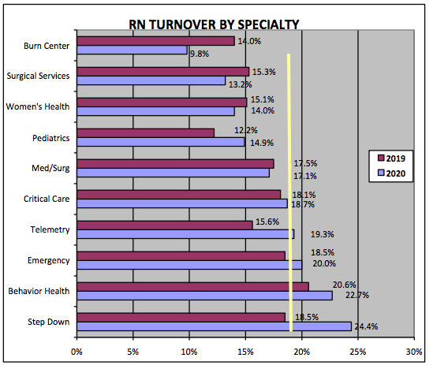
Current State
Team 4.11
Burnout
Attrition and costs
No "best practice" model
Notes:
Here is the current state:
If we look at the chart on the left, there is a variant increase in inpatient units, like step down services!
There are significant costs to replace a nurse, sometimes between $40-$64,000
Current patient classification systems in the U.S. mainly focus on resource allocation and staffing matrices, not the allocation of patient assignments or workload to the nurse.

Slide 8

Solution Architecture
Team 4.11
Data mining tool
Predictive analytics of data points
Notes:
Our solution will be a data mining tool that pulls information from an existing EMR and quantifies documented data points using an algorithm to measure workload. Objective data points will include factors, such as frequency of call lights, isolation precautions, ordered tests and procedures, and other clinical objective data.

Slide 9

Incurred Costs
Team 4.11
Supplies
Labor
Target markets
Notes:
Collaborative partnerships with EMR companies, especially in the design phase
Other costs would include servers and gateways, other means of networking, as well as labor and productivity costs of product and implementation staff
This is a purely business-to-business venture, and our target markets are enterprise healthcare systems. The solution we provide will be optimal for revolutionizing their current workflow processes.

